Slide 1
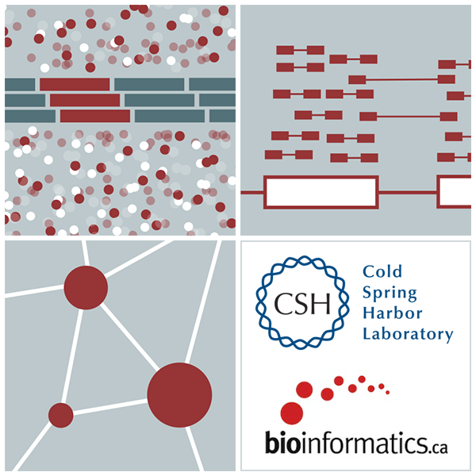
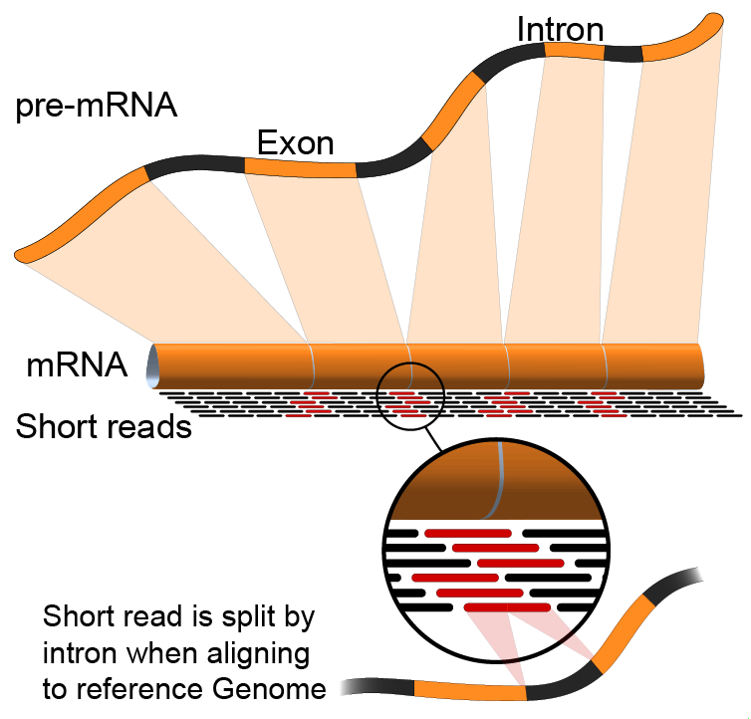

Introduction to single cell RNA sequencing and analysis
Kelsy Cotto, Malachi Griffith, Obi Griffith, Evelyn Schmidt, Kartik Singhal, Zach Skidmore
CRI Bioinformatics Workshop. May 17-22, 2025

Slide 2
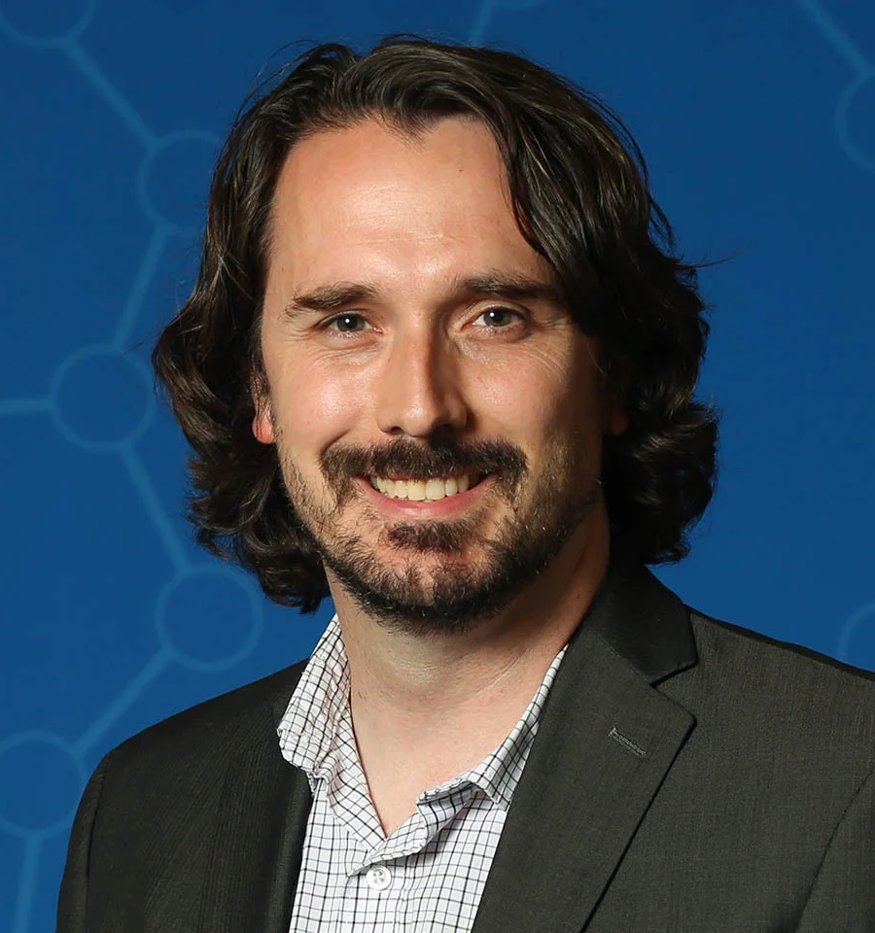
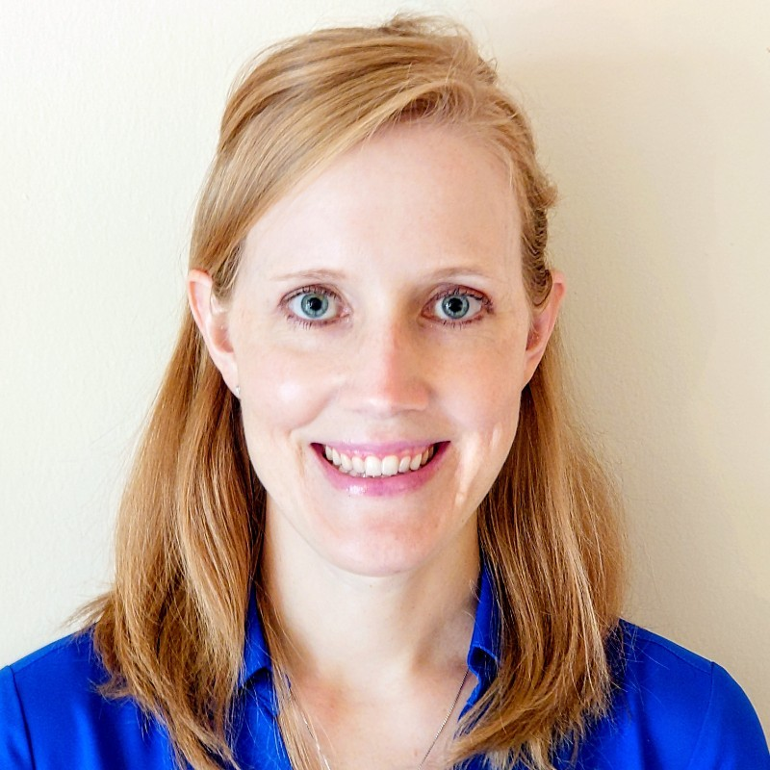
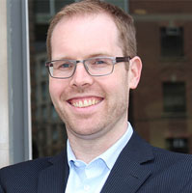
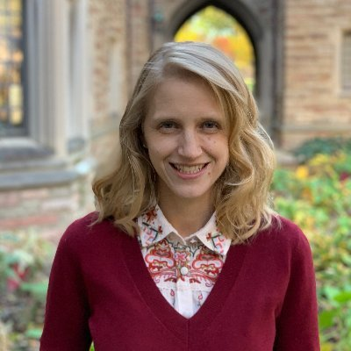
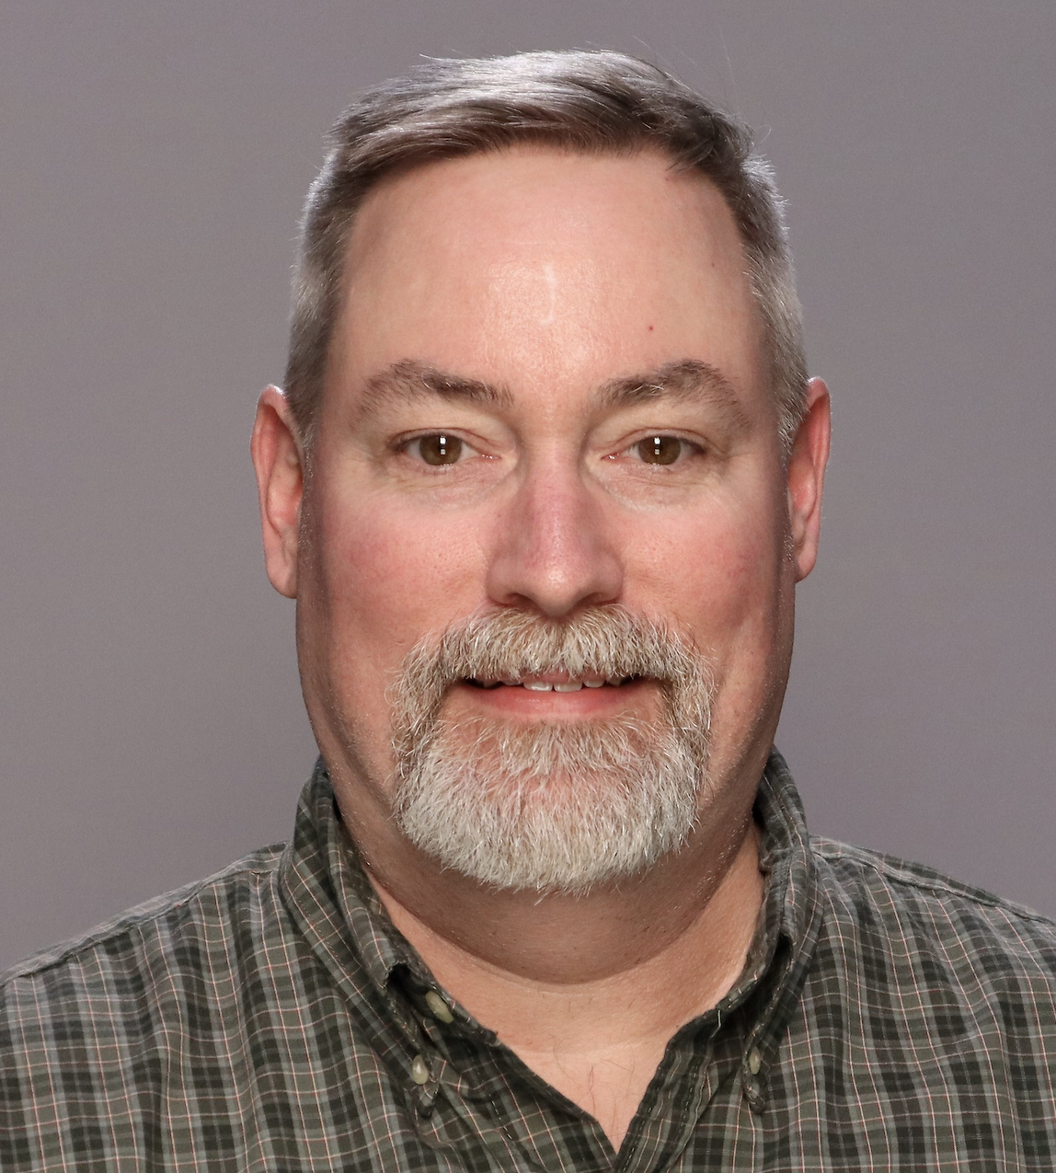
Acknowledgements
Jon Preall, CSHL, SEQTEC
Jennifer Foltz, Washington University, Genomics in Medicine
Trevor Pugh, PMH, OICR, CBW
Allegra Petti, MGH/Harvard
Brian Haas, Broad Institute

Slide 3
Single-cell omics - A new paradigm in biology and medicine?
Redefine “cell type”
Catalog known cell types in healthy and diseased tissues
Define/discover new cell types
Redefine relationships between cells
Interpret genetic variation at single-cell resolution

Slide 4
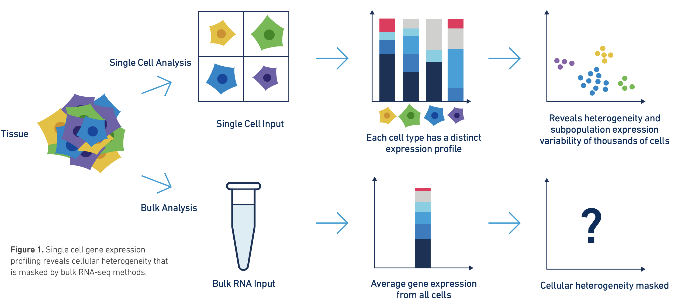
Discussion of bulk vs single cell RNA-seq
Image from 10x genomics
Factors to compare: Cost, complexity of library prep, complexity of analysis, qualitative and quantitative differences in richness of information obtained.
Notes:
Simple differences. Cost. 200 million reads gives you a rich representation of transcriptome in bulk context but signal is averaged across cells. 500 million reads in an scRNA-seq experiment by contrast gives you are relatively sparse view of the transcriptome of 4-10k individual cells.
Simple differences. Complexity of library prep and analysis is higher for scRNA.
Most importantly. Single cell data gives information about individual cells. In bulk RNAseq analysis the signal from multiple cells is averaged together. Deconvolution approaches are possible with bulk RNA-seq but hard. Single cell becomes more valuable depending on how heterogeneous your sample is, and how important it is to understand the composition of cell types present and interaction between cells.
Bulk RNA-seq is giving a readout of more cells, way, way, way more cells
Bulk RNA-seq can robustly detect gene expressed at a very low copy number per cell
Bulk RNA-seq can provide information from the whole length of transcripts. Single cell protocols remain end biased. This has implications for detecting expression of variant alleles, isoform quantification, fusion detection, etc.
Support of long read sequencing platforms is in the early stages for the scRNA approach
Bulk RNAseq can be done with very minimal manipulation of cells. The result may be a relatively unbiased survey of transcripts in that tissue. polyA transcripts and those that are not. Long transcripts, short transcripts, abundant and rare. Transcripts from cells that are fragile. Transcripts from cells that are large and small.

Slide 5

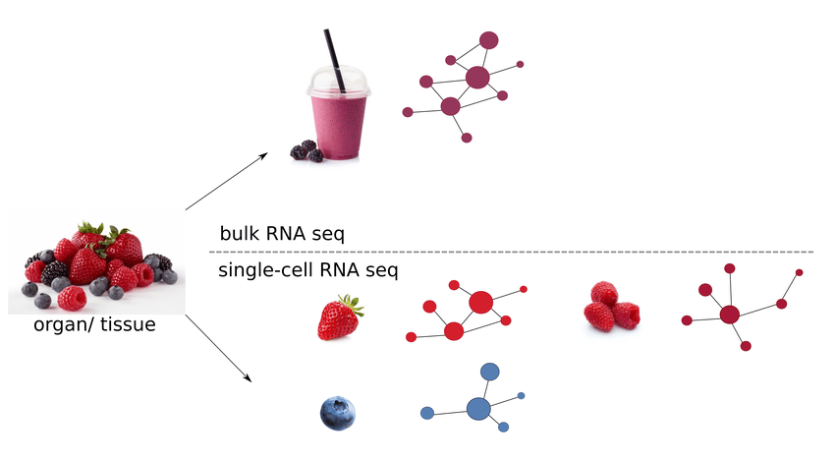
Fruit salad or tip of the iceberg?
scRNA
Notes:
https://www.researchgate.net/figure/Difference-in-resolution-from-bulk-and-single-cell-RNA-seq-data-on-the-level-of-gene_fig1_350593672

Slide 6
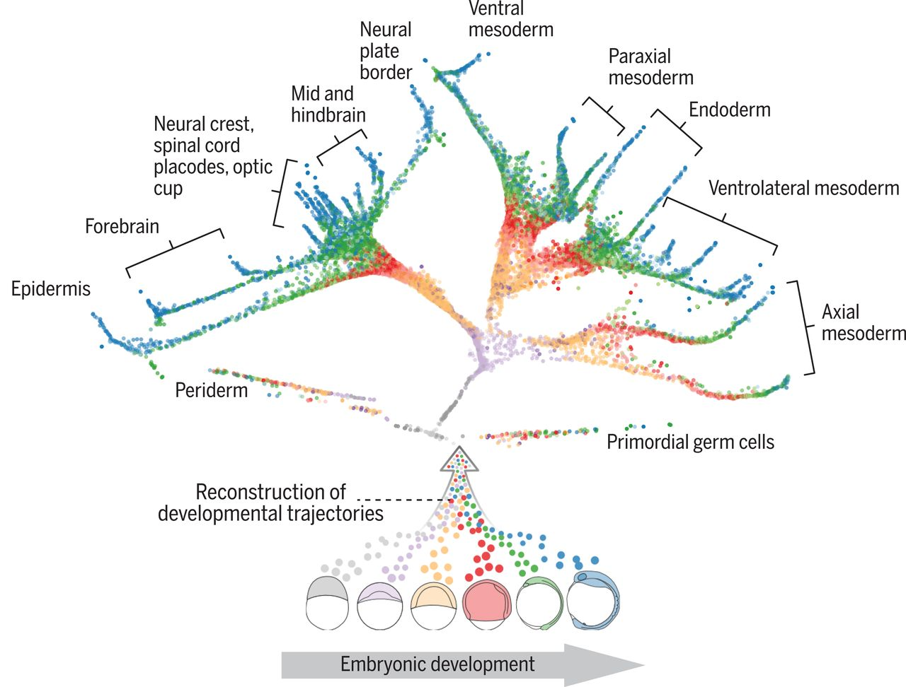
Cell type vs cell lineage vs cell state
https://www.science.org/doi/10.1126/science.aar3131
Notes:
Cell type (stable, “hard-wired”, e.g. by transcription factors)
Lineage (often continuous)
State – variable and continuous, reprogrammable, ”soft-wired”
Normal range of cell states vs pathological range

Slide 7
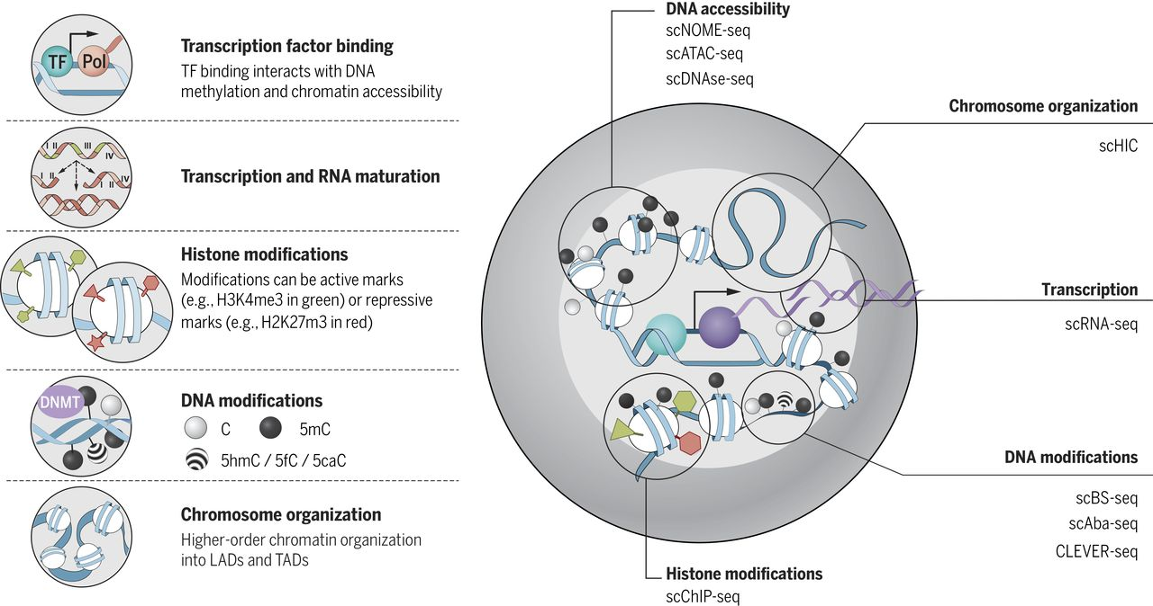
Multimodal single-cell measurements
CITE-seq
TCR sequencing
scATAC-seq
scMethyl-seq
TARGET-seq, G&T-seq (scDNA & scRNA)
scCRISPRi/Perturb-seq
Patch-seq
Spatial transcriptomics
Kelsey et al. Science 2017

Slide 8
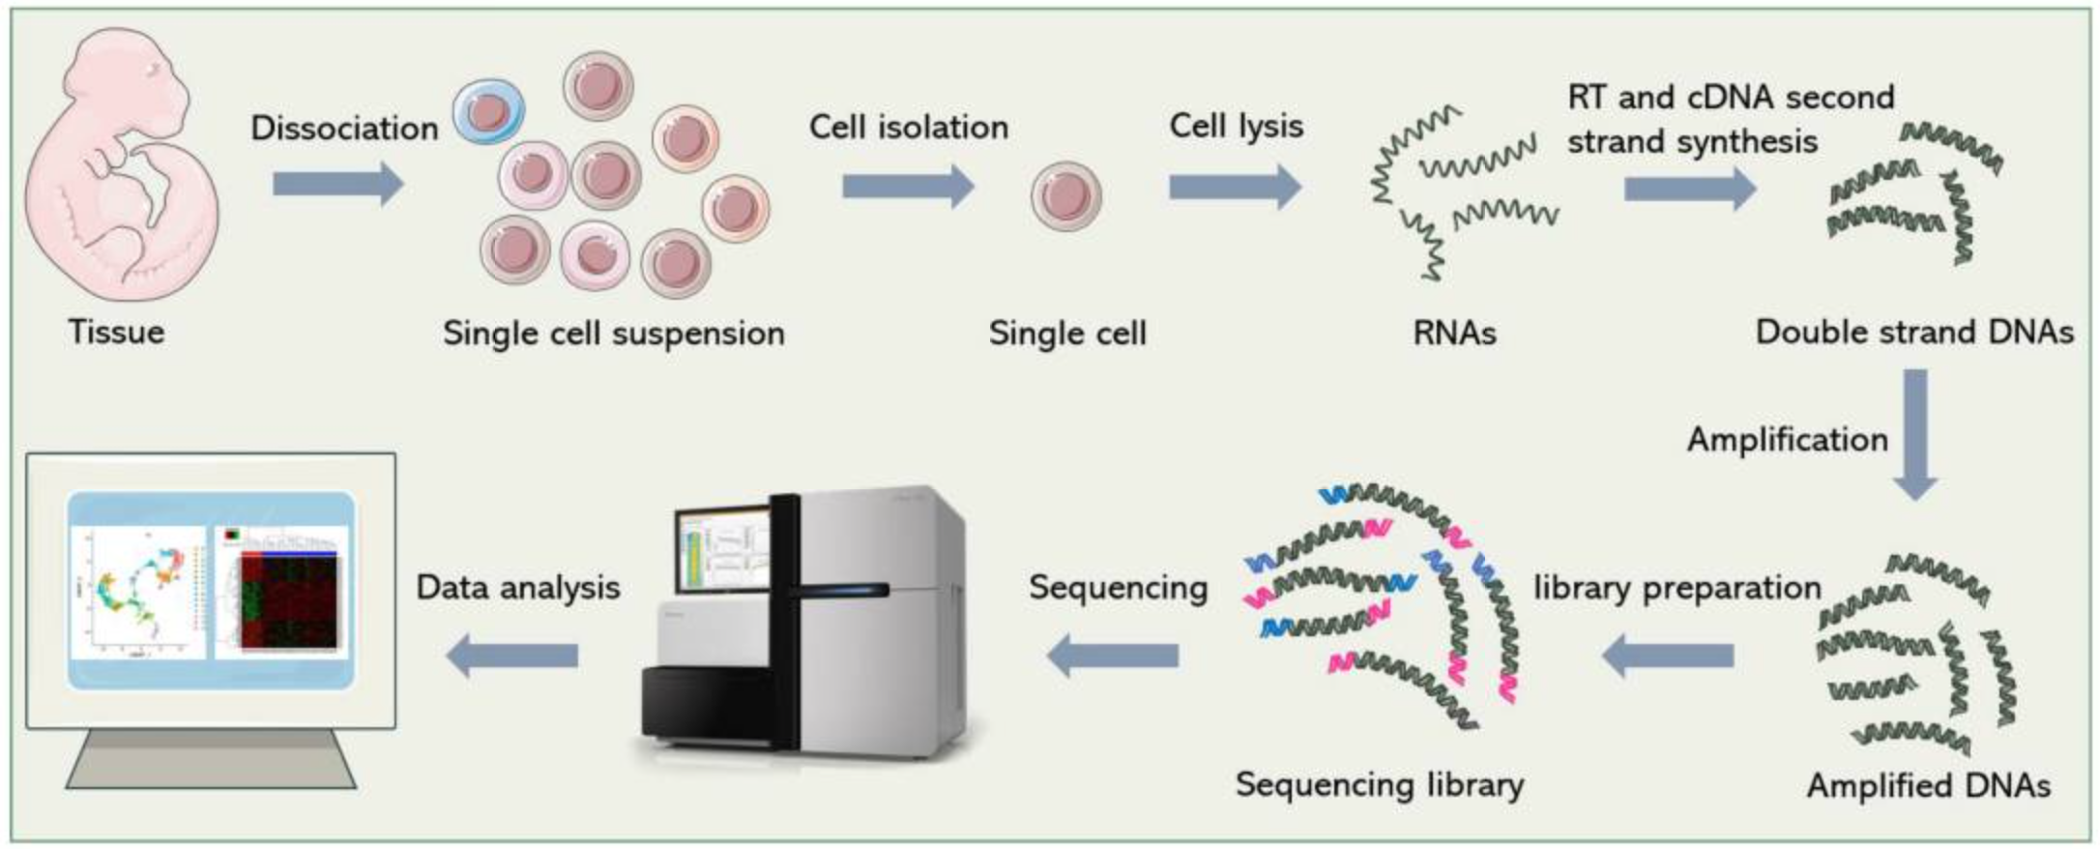
Basic overview of single cell RNA analysis
Notes:
https://www.ncbi.nlm.nih.gov/pmc/articles/PMC9312765/

Slide 9
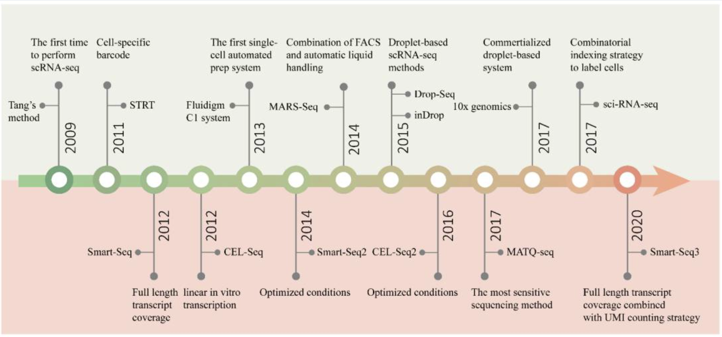
History of scRNA-seq Technology development
Notes:
https://www.ncbi.nlm.nih.gov/pmc/articles/PMC9312765/

Slide 10
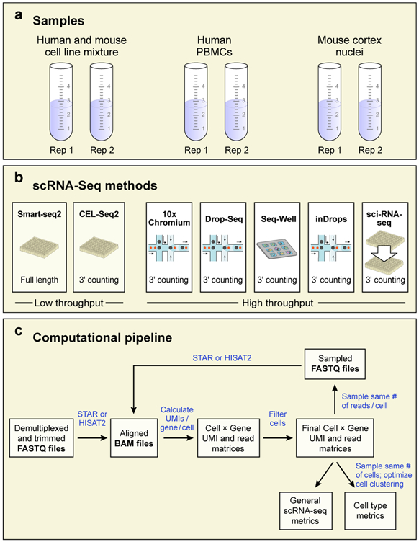
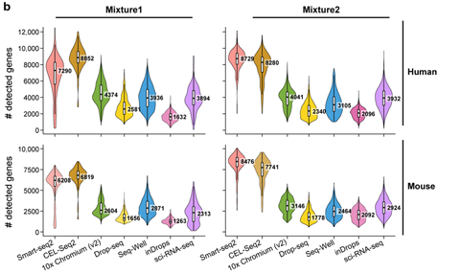
Multiple platforms have emerged ... Each with trade-offs…
Notes:
https://www.ncbi.nlm.nih.gov/pmc/articles/PMC7289686/
Plate-based
- More comprehensive coverage of transcriptome (depth/breadth)
Droplet-based
- More cells

Slide 11
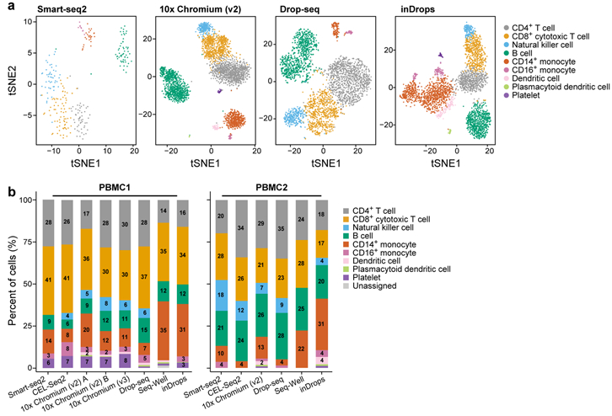
Multiple platforms have emerged ... Each with trade-offs…
Notes:
Different technologies might have different sensitivity and specificity for different cell types.
- Cell size preferences
- Sampling issues for lower cell count approaches

Slide 12
Additional considerations
Size of cells
Expected % of cell population of interest
Depth of detection needed for experimental question
Accessibility

Slide 13
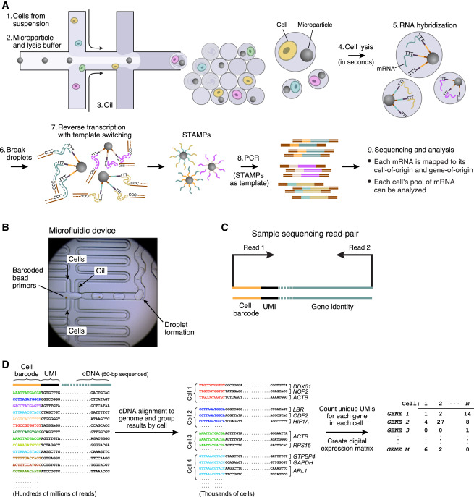
Intro to 10X approach

Slide 14
Intro to 10X approach

Slide 15
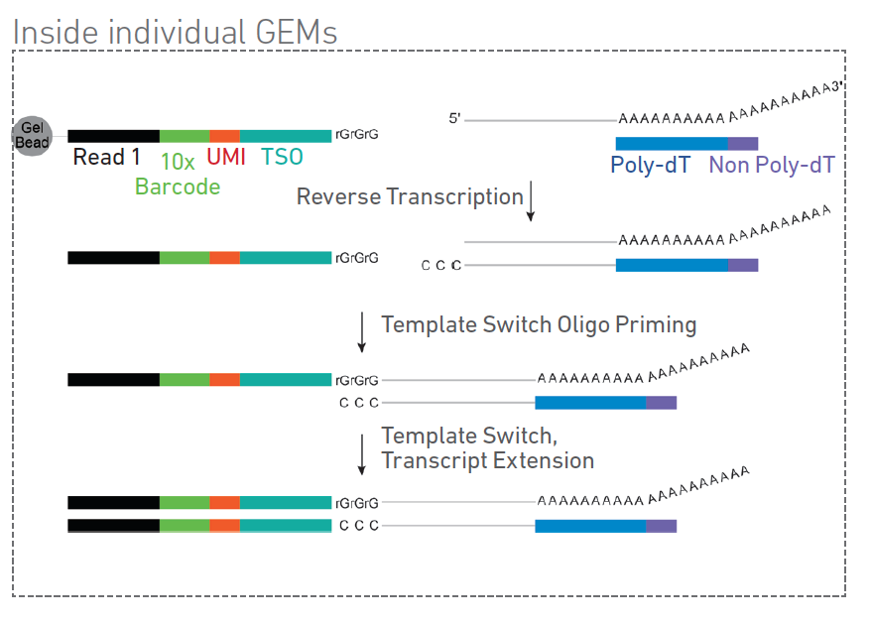
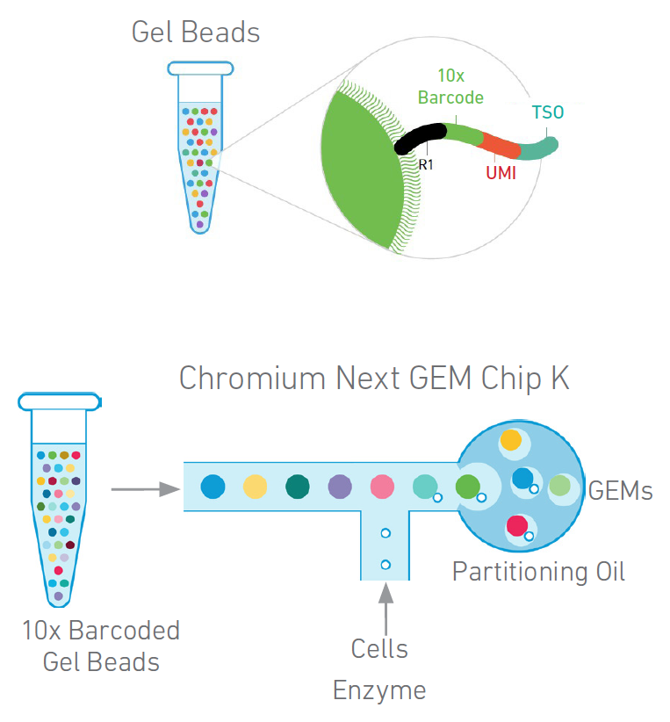
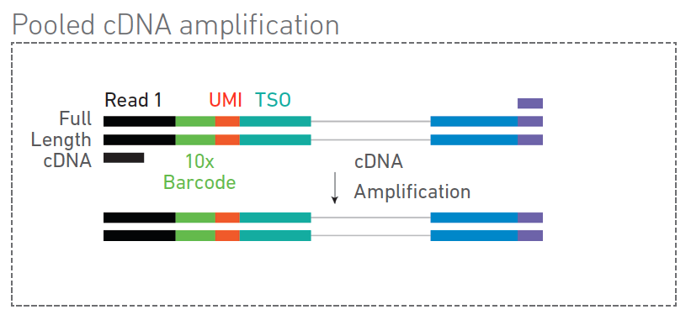
10X (5’) v1/v2 Approach
Notes:
Gel beads, Master Mix with cells to be profiled, and partitioning oil are combined to form so called Gel beads-in-emulsion (GEMs). Cells are delivered at a limiting dilution such that most (~99%) GEMs actually have zero cells and the rest have mostly one cell (occasionally doublets can occur and must be addressed later in analysis). Each gel bead carries oligonucleotides with the Illumina Read 1 sequencing primer, one of ~750,000 unique “cell barcodes”, a unique molecular identifier (UMI) sequence, and a template switch oligo (TSO). Once GEMs are formed, the cell is lysed and gel bead dissolved releasing the oligos, to be mixed with reverse transcription (RT) reagents and poly(dT) RT primers.
Inside each individual GEM a reverse transcription is initiated for polyA mRNA using a poly-dT primer (with non-poly-dT tail). As the RT reaches the 5’ end of the mRNA template, a specific kind of Terminal nucleotidyl transferase (TdT) activity is induced to add three non-template (C)ytosines. The TSO hybridizes to these non-template Cs allowing RT template switching from the mRNA fragment to the 10X oligo. Transcript extension produces full length cDNA that represents the original mRNA from polyA tail tl 5’ end with the 10X sequences (TSO, UMO, Cell Barcode, and R1) now attached.
The pooled cDNA is amplified using primers for the Read 1 sequence and the non-poly-dT tail.
All the generated cDNA in an individual GEM share a common 10x Barcode. When libraries are generated and sequenced, these Barcodes are used to associate individual reads back to the individual cells.
https://www.thermofisher.com/us/en/home/life-science/cloning/cloning-learning-center/invitrogen-school-of-molecular-biology/rt-education/reverse-transcriptase-attributes.html
Terminal nucleotidyl transferase (TdT) activity
Reverse transcriptases may display terminal nucleotidyl transferase (TdT) activity, which results in non–template-directed addition of nucleotides to the 3′ end of the synthesized DNA. TdT activity occurs only when the reverse transcriptase reaches the 5′ end of the RNA template, adds 1–3 extra nucleotides to the cDNA end, and exhibits specificity towards double-stranded nucleic acid substrates (e.g., DNA:RNA in the first-strand cDNA synthesis and DNA:DNA in the second-strand cDNA synthesis). In general, this intrinsic activity is undesirable because the added nucleotides do not correspond to the template. The non–template-directed nucleotide addition commonly occurs with the preference in the order of A>G≥C>T [9,11].
Different reverse transcriptases possess varying degrees of intrinsic TdT activity. With wild-type MMLV and AMV reverse transcriptases, 25–90% of synthesized DNA strands may contain extra nucleotides at the 3′ end. Engineered MMLV reverse transcriptases, on the other hand, tend to display reduced intrinsic TdT activity. In addition to reverse transcriptase choice, the rate of nucleotide addition depends on reaction conditions such as the RNA:enzyme ratio, enzyme amount, incubation time, and reaction temperature [9].
For certain applications such as full-length cDNA cloning, rapid amplification of cDNA ends (RACE), and RNA sequencing (RNA-Seq), reverse transcriptases may be induced to intentionally add a string of Cs to the 3′ end of the cDNA. This type of TdT activity can be triggered during, or in a later phase of, cDNA synthesis by high concentrations of magnesium and/or manganese ions [12,13]. Combined with a specially designed DNA oligo with a string of 3′ Gs (called a template-switching oligo), TdT activity can specifically modify the 3′ cDNA end and the 5′ RNA end (Figure 8). Examples of these sequence modifications include the introduction of a restriction site for subsequent cDNA cloning steps and/or addition of adapters for downstream RNA sequencing steps [14-16].
https://kb.10xgenomics.com/hc/en-us/articles/360001493051-What-is-a-template-switch-oligo-TSO-
The TSO (template switch oligo) is an oligo that hybridizes to untemplated C nucleotides added by the reverse transcriptase during reverse transcription. The TSO adds a common 5' sequence to full length cDNA that is used for downstream cDNA amplification.
https://www.idtdna.com/pages/education/decoded/article/use-of-template-switching-oligos-(ts-oligos-tsos)-for-efficient-cdna-library-construction
The simple version of a template switching (TS) oligo is a DNA oligo sequence that carries 3 riboguanosines (rGrGrG) at its 3' end [1]. The complementarity between these consecutive rG bases and the 3' dC extension of the cDNA molecule empowers the subsequent template switching [5]. These bases function as a template switching (TS) oligo-anchoring site. Upon base pairing between the TS oligo and the appended deoxycytidine stretch, the reverse transcriptase “switches” template strands, from cellular RNA to the TS oligo, and continues replication to the 5' end of the TS oligo. By doing so, the resulting cDNA contains the complete 5' end of the transcript, and universal sequences of choice are added to the reverse transcription product. Along with tagging of the cDNA 3' end by oligo dT primers, this approach makes it possible to efficiently amplify the entire full-length transcript pool in a completely sequence-independent manner

Slide 16
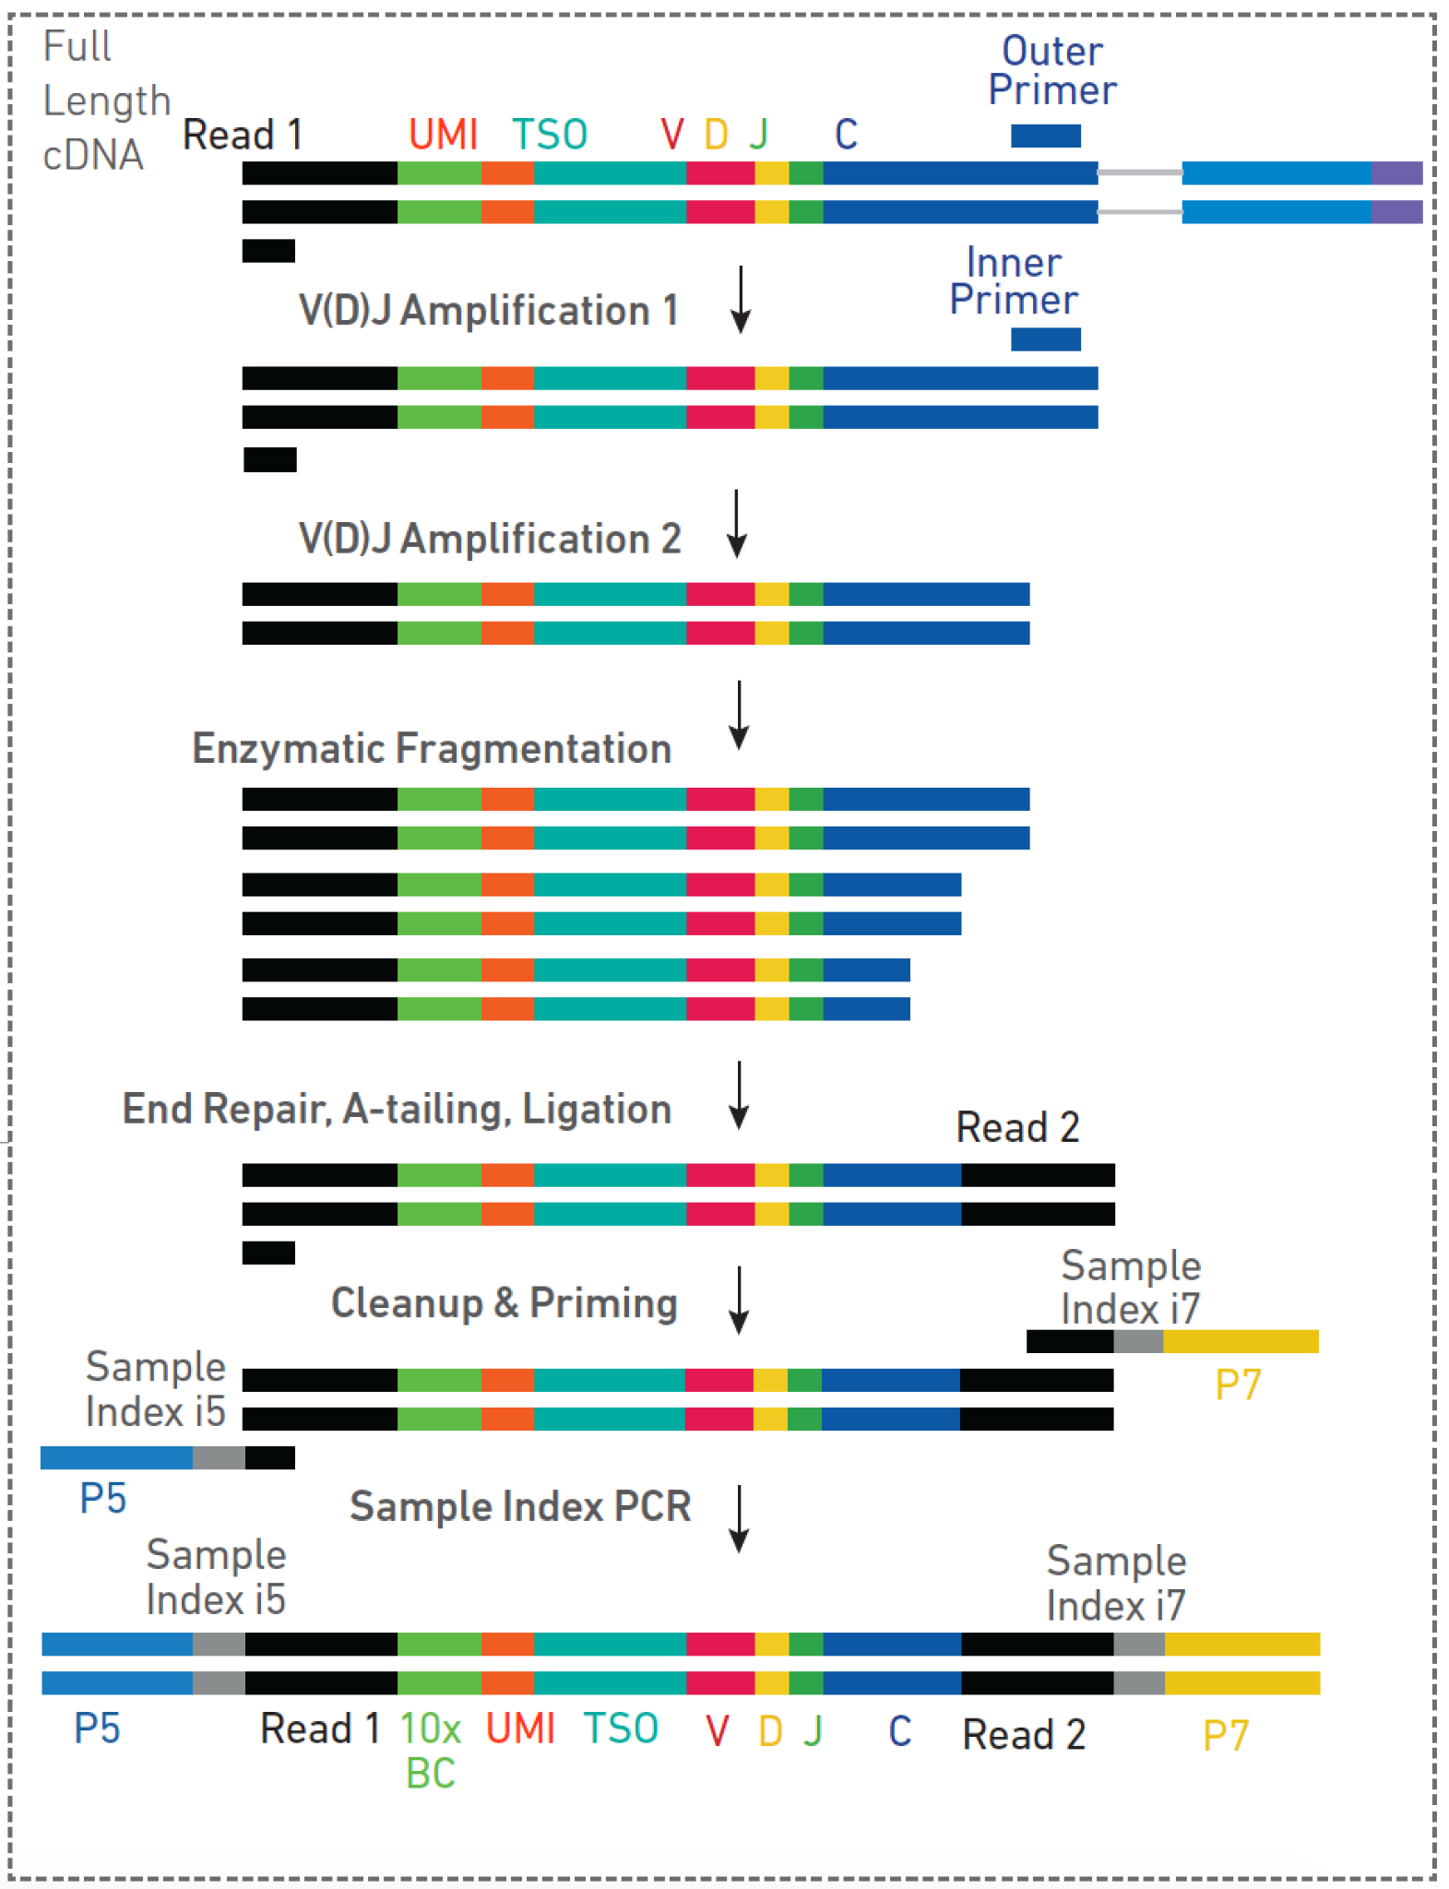
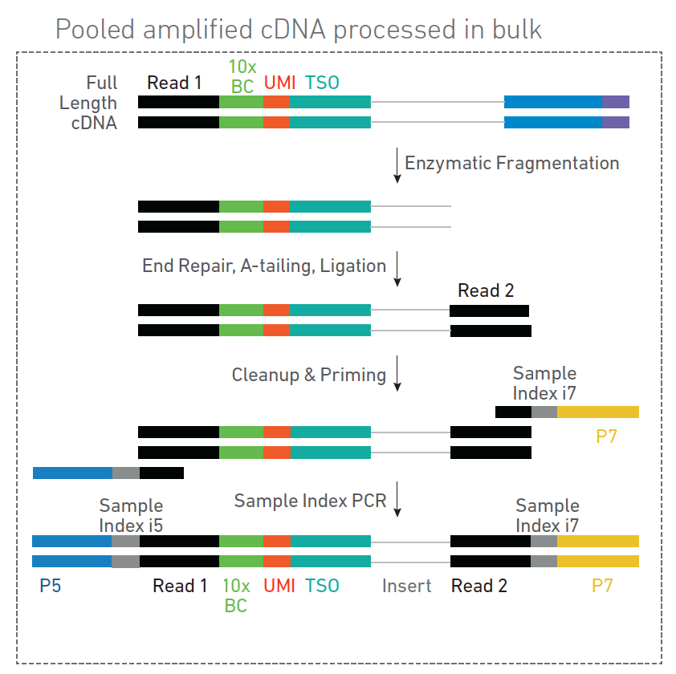
10X (5’) v2 Approach
Notes:
Changes In V2
A second Sample Index (i5) was incorporated during the Sample Index PCR for both GEX and VDJ protocols
For VDJ library prep, the P5 sequence adaptor is now only included during Sample Index PCR along with i5, instead of as a tail during VDJ enrichment step 1, as done in the V1 protocol. A single consistent left primer matching the Illumina R1 sequence is used in both VDJ enrichment steps. This sacrifices some theoretical specificity in the nested PCR for simplicity and for the benefits of dual sample indexes.
Note: We actually did the v1 enrichment strategy along with the v2 final library prep steps. This worked because the v2 Sample Index PCR step primes off Illumina Read1 sequence. We effectively replaced our P5 tails with new i5+P5 tails.

Slide 17
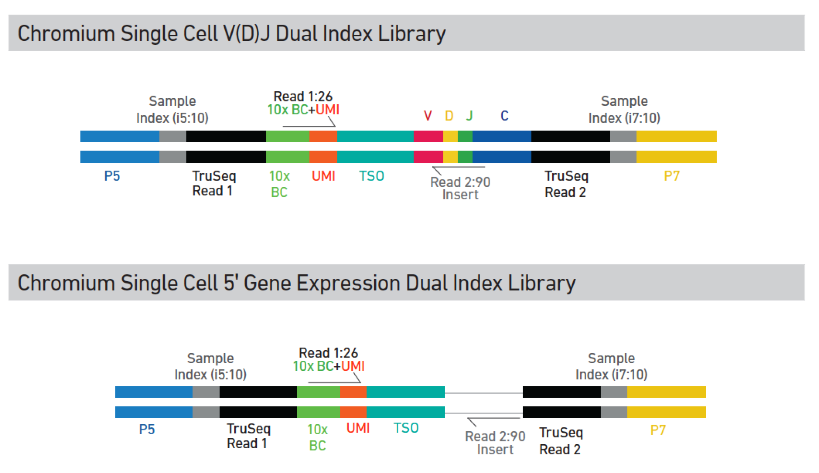
10X Single Cell 5’ GEX and V(D)J dual index libraries
Notes:
The 10X recommended sequencing protocol produces 4 reads per cluster: 10bp i5 and i7 sample indexes, a minimum of 26bp Read1 to ensure 10 Barcode and UMI are capture, and a minimum 90bp read2 that covers the transcript fragment. At GTAC/MGI we currently perform 2x151 R1/R2 reads which results in 151bp - 26bp BC/UMI - 13bp TSO = 112bp for R1 and 151bp for R2.
4 Reads:
i5 sample index: 10bp
i7 sample index: 10bp
Read1: Minimum required by 10X 26bp -> At MGI 151bp - 26bp BC/UMI - 13bp TSO = 112bp
Read2: Minimum required by 10X 90bp -> At MGI 151bp

Slide 18
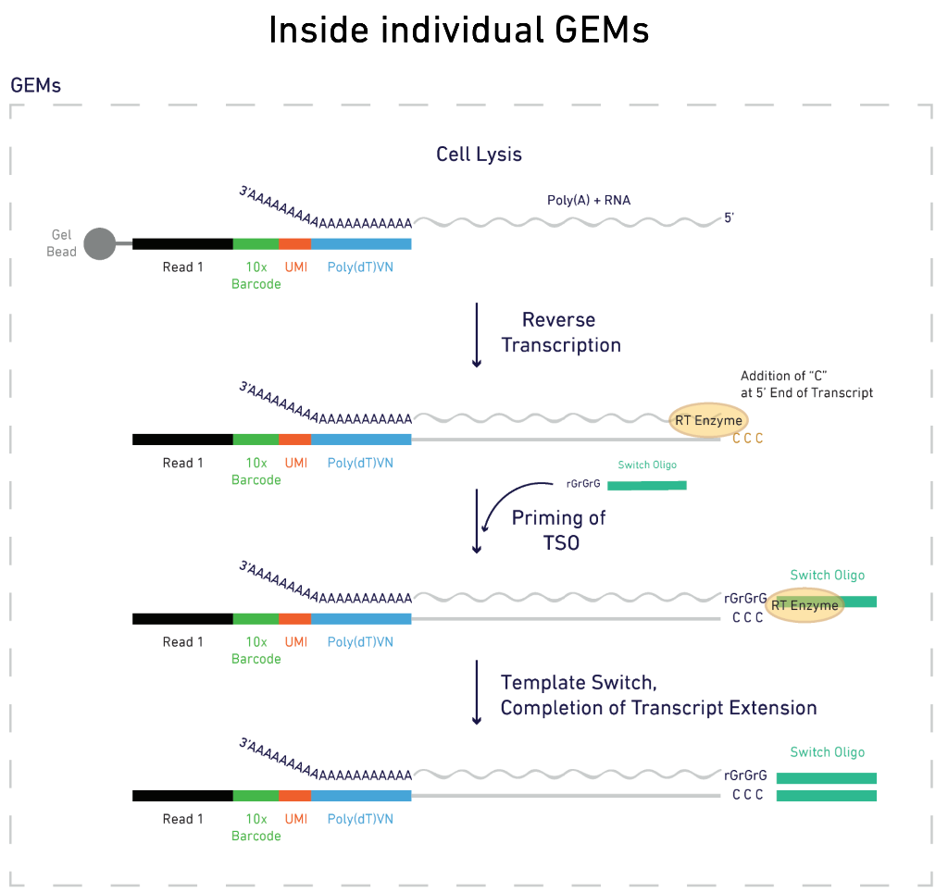
5’ vs 3’ approach - polyT and TSO switch places
Notes:
In the 10X 3’ approach, the polydT primer is incorporated into the gel bead oligo and the TSO is by itself at the 5’ end. The Illumina Read 1 sequencing primer, 10X barcode, and UMI are at the 3’ end of resulting cDNA instead of 5’ end. Otherwise the protocols are highly similar

Slide 19
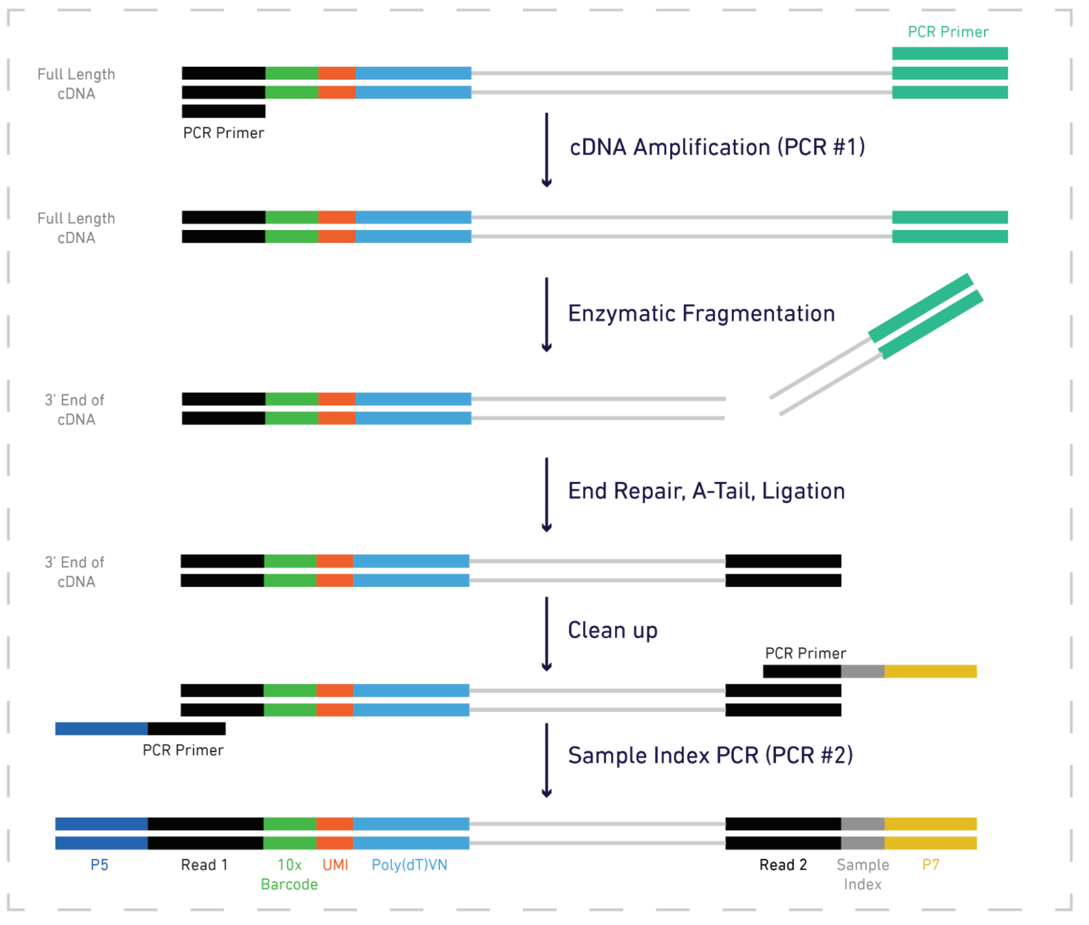
5’ vs 3’ approach - Fragmentation and PCR steps result in different ends of transcripts being kept
5’ -> 3’
3’ <- 5’
Notes:
In both cases, fragmentation targets 300-400bp fragments. The Sample Index PCR steps depends on the presence of the R1 sequence. This effectively anchors the resulting products to the either the 5’ or 3’ end.
https://kb.10xgenomics.com/hc/en-us/articles/360000939852-What-is-the-difference-between-Single-Cell-3-and-5-Gene-Expression-libraries-
Question: What is the difference between Single Cell 3' and Single Cell 5’ Gene Expression libraries?
Answer: The two assays are similar but capture different ends of the polyadenylated transcript in the final library. Both solutions use polydT primer for reverse transcription, although in the 3' assay the polydT sequence is located on the gel bead oligo, while in the 5' assay the polydT is supplied as an RT primer. A template switching oligo (TSO) is used in both workflows to reverse transcribe the full-length transcript.
After amplifying the cDNA, molecules are randomly fragmented under conditions that favor 300-400 bp length fragments. Downstream of fragmentation, only transcripts containing both (1) a 10x Barcode AND (2) an Illumina Read 2 adaptor, which is ligated on to the cDNA after fragmentation, will be amplified during the Sample Index PCR. This results in final 10x libraries that either represent the 3' end of the transcript (as the 10x Barcode is adjacent to the polyA tail on the 3' end of the transcript) or the 5' end of the transcript (as the the 10x Barcode is adjacent to the TSO and the 5' end of the transcript).

Slide 20
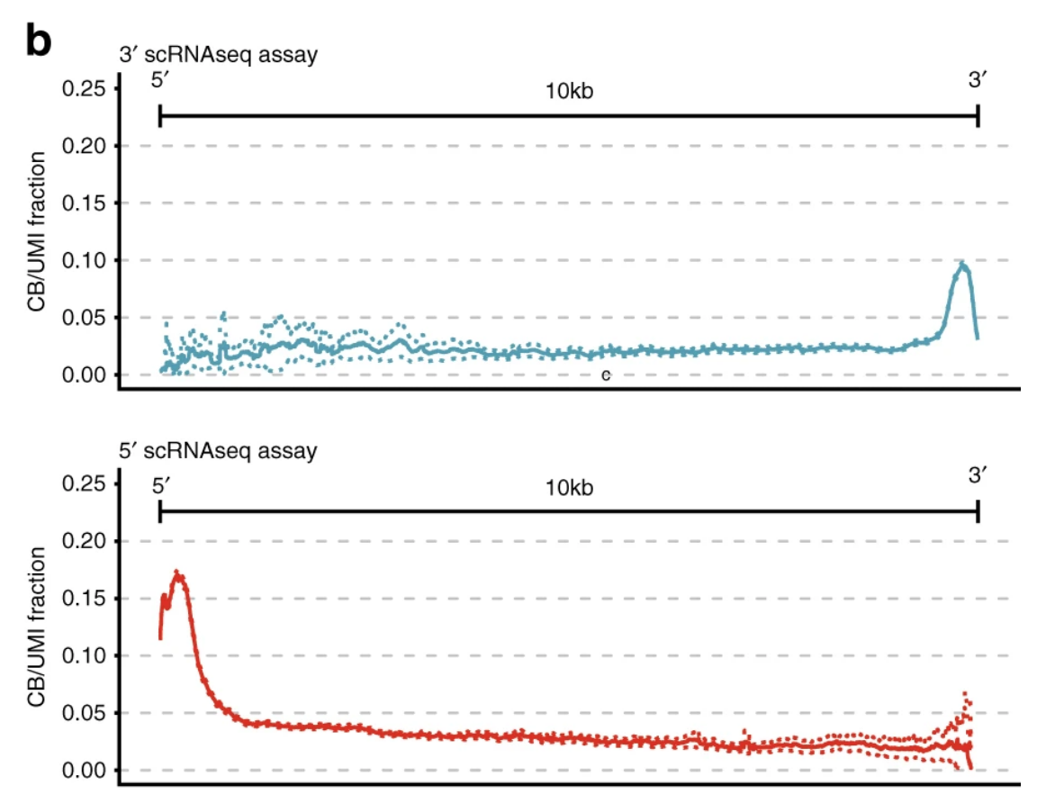
5’ vs 3’ approach results in different end bias
Fig1b. Petti et al. 2019. Nat Comm

Slide 21
5’ vs 3’ approach
Both require polyA transcripts
Both involve end bias (choose 3’ or 5’)
5’ coverage more evenly distributed?
Only 5’ approach is compatible with V(D)J enrichment
Because business end of V(D)J transcript is at 5’ followed by large C region at 3’ end
In order to amplify TCR from 3’ 10X library you would need very large fragments and would have to design primers off the variable V genes instead of constant C gene

Slide 22
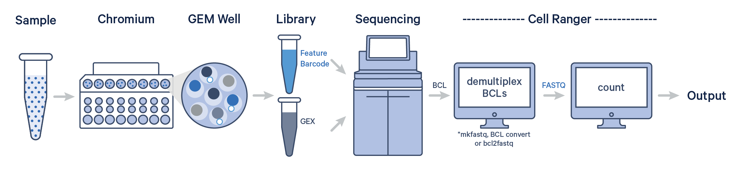
Overview of 10x genomics pipeline

Slide 23
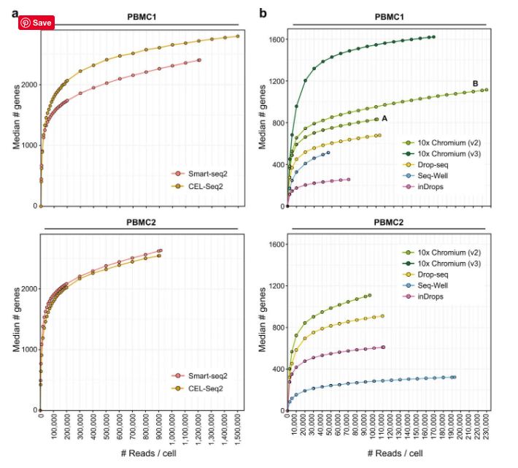
How deeply do you need to sequence?
General Rule:
Achieve 90% saturation
Official Recommendations (reads/cell):
3’ - V3: 20K
3’ - V2: 50K
5’ - 20K
5’ with variant discovery - 200K
5’ V(D)J - 5K
Fixed RNA: 10K
Ding J, et al. (2020) Nature Biotech. 38:737-746

Slide 24
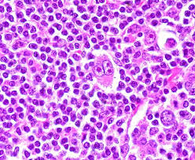
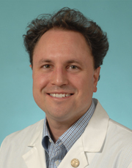

Example application: Increased capacity and new technologies are allowing study of previously inaccessible tumor types
Hodgkins Lymphoma - has remained a challenge because HRS cells account for ~1-5% of cells in the tumor tissue.
Isolate HRS cells and then apply genomic techniques
Flow sorting – very challenging cell type
Laser capture microdissection – extremely low inputs for sequencing
Handful of cell lines have been profiled
Almost no genome-wide sequencing data exists
Todd Fehniger
Felicia Gomez

Slide 25
Brute force strategy - Ultra Deep Exome sequencing of 31 Hodgkins tumor/normal pairs
IDT Exome capture reagent
Three KAPA libraries were constructed/sample
Libraries were sequenced across eight lanes of an Illumina HiSeq
Somatic Variant Calling
SNV were called using 5 variant callers
Indels were called using 4 variant callers
Target depth ~1000x
Validation with targeted Haloplex technology

Slide 26
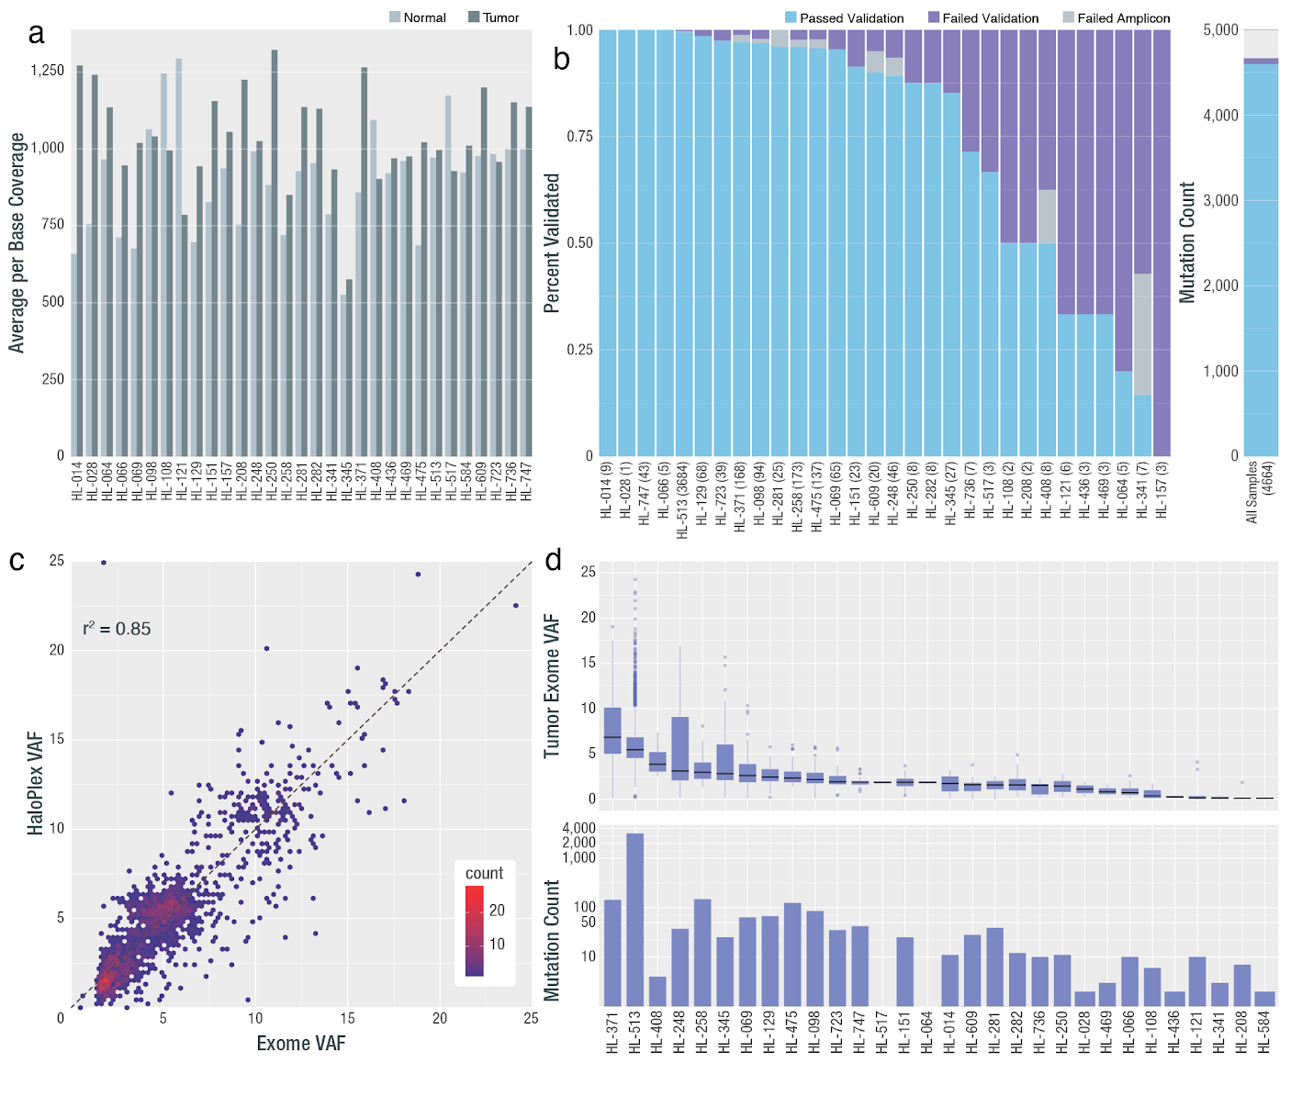
High coverage and concordance achieved
~1000X coverage achieved
High VAF concordance between WES and haloplex validation
Overall variant validation rate >90%
Mean mutation burden = 33 protein-coding variants
One hypermutator 3,160 variants

Slide 27
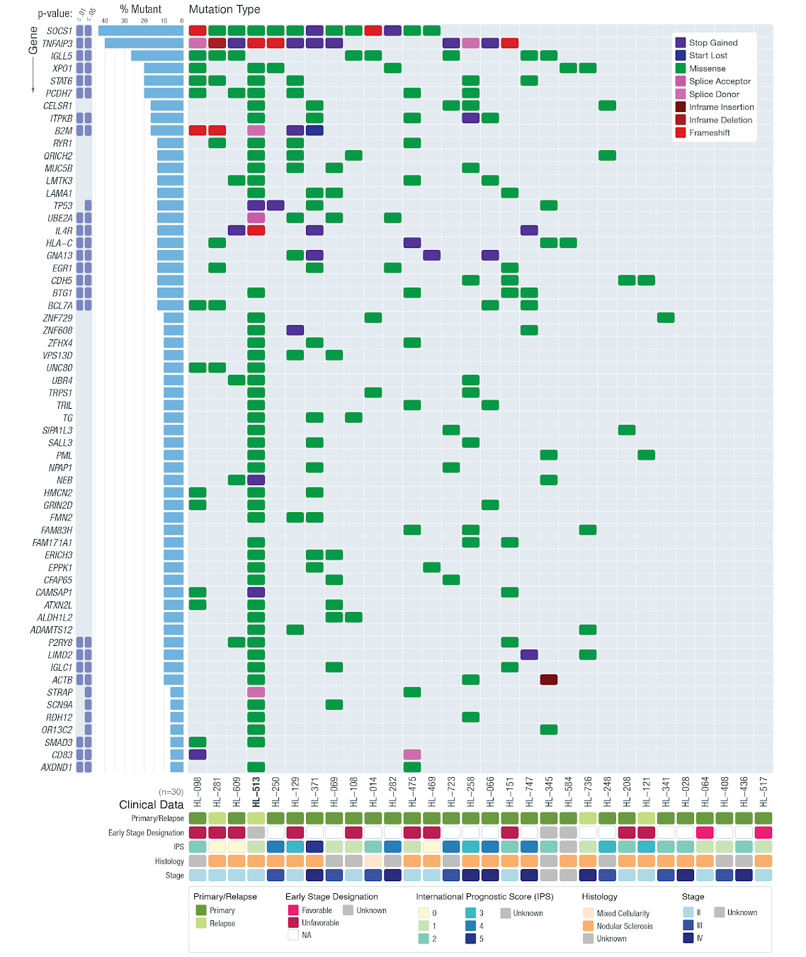
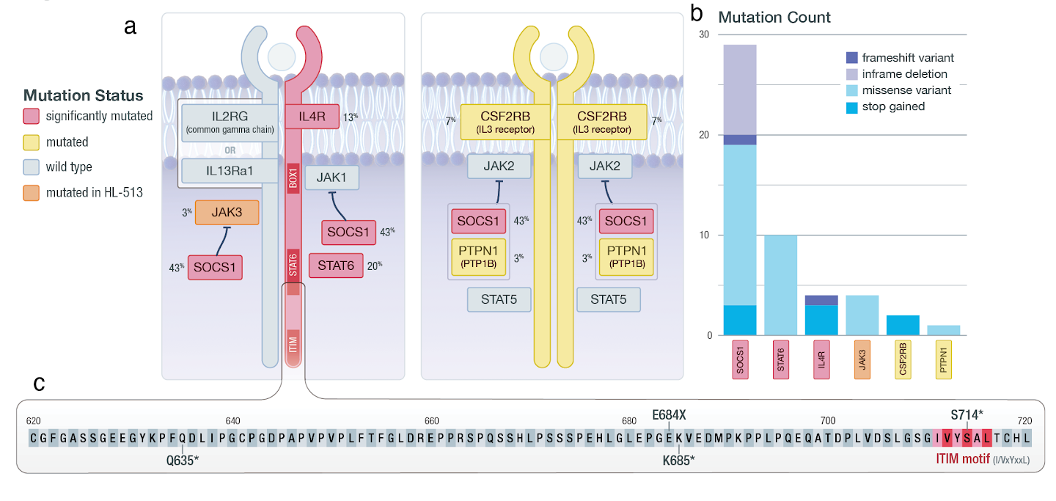
Represents one of the few comprehensive surveys of HL - mutation landscape reveals known and novel genes/pathways/hotspots
~50 genes have mutations in 3 or more samples
JAK/STAT - SOCS1 & STAT6
NFKB - TNFAIP3 & XPO1
SWI/SNF - BCL7A & SMAD3
PCDH7, IGLL5, CDH5, …

Slide 28
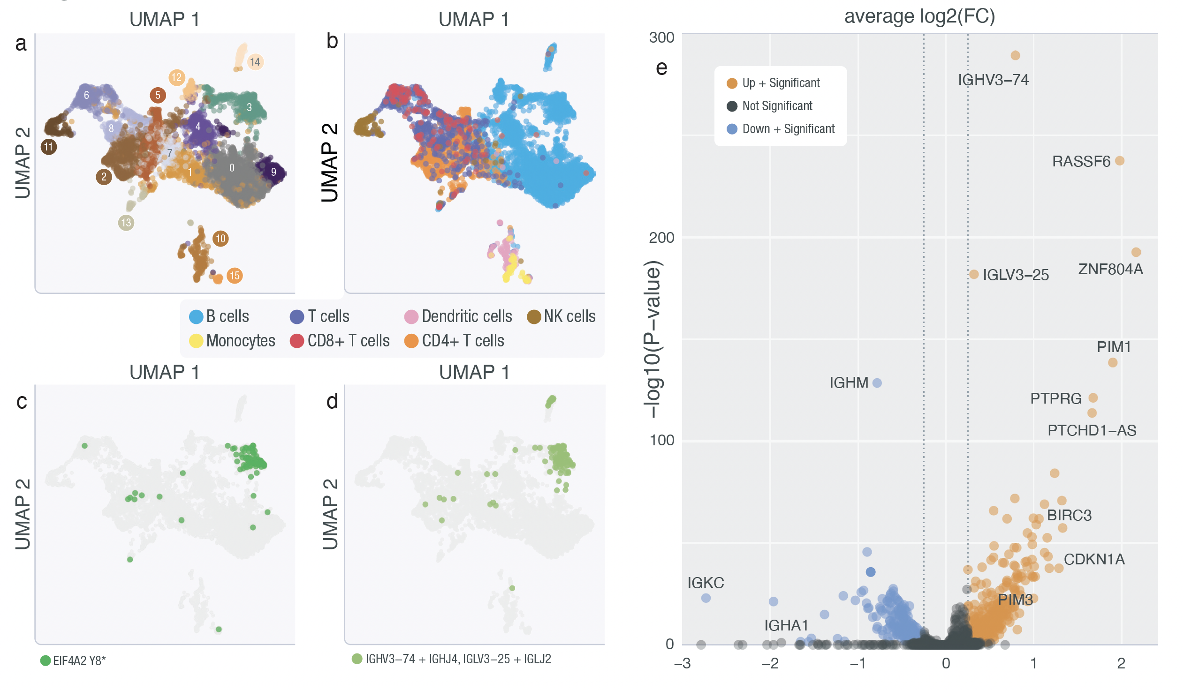
Single nucleus sequencing identifies mutant-positive HRS cells

Slide 29
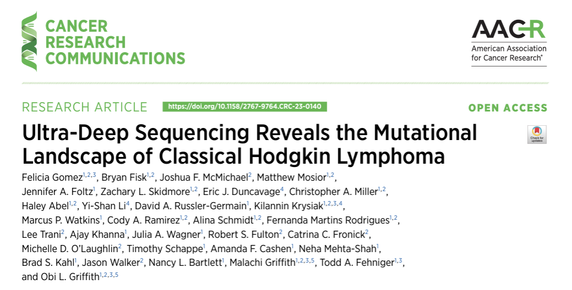

Slide 30
Introduction to scRNA dataset for hands-on exercises
https://rnabio.org/module-08-scrna/0008/01/02/scRNA_Data/
Includes brief demo of CellRanger QC Reports and Loupe Browser

